Slide 1
IT Infrastructure Architecture
Infrastructure Building Blocks
and Concepts
Availability Concepts
(chapter 4)

Slide 2
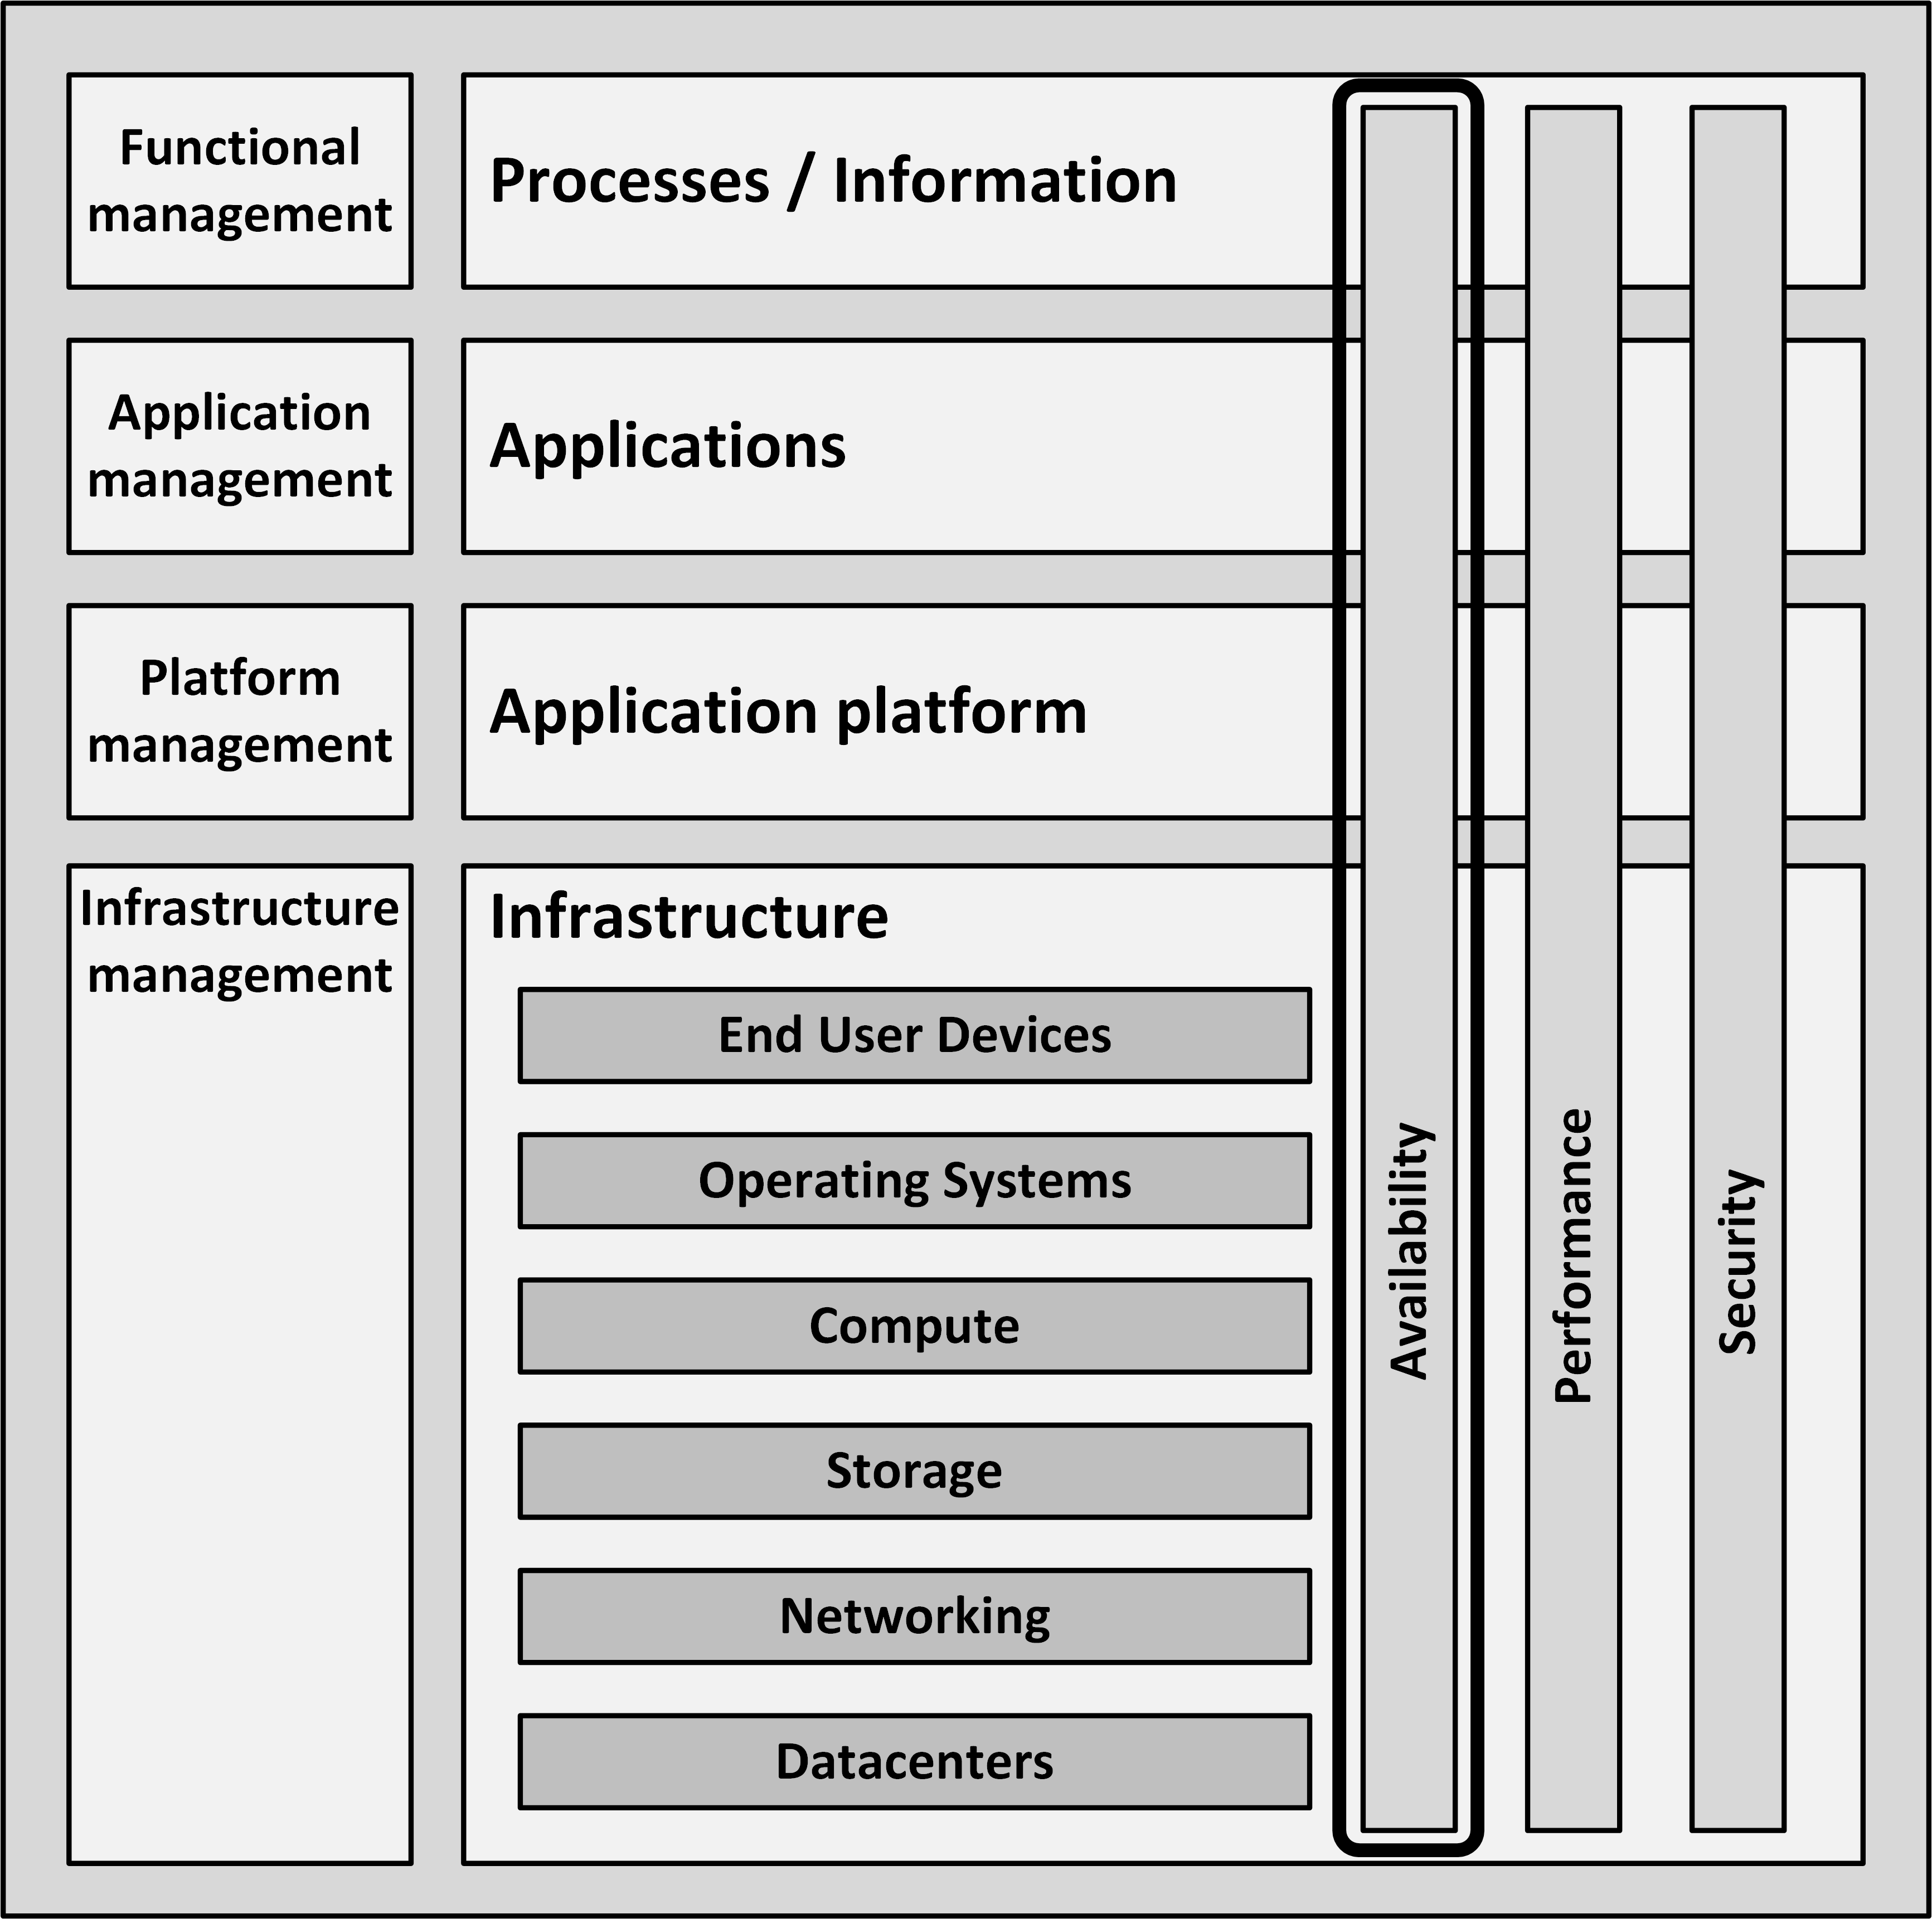
Introduction
Everyone expects their infrastructure to be available all the time
A 100% guaranteed availability of an infrastructure is impossible

Slide 3
Calculating availability
Availability can neither be calculated, nor guaranteed upfront
It can only be reported on afterwards, when a system has run for some years
Over the years, much knowledge and experience is gained on how to design high available systems
Failover
Redundancy
Structured programming
Avoiding Single Points of Failures (SPOFs)
Implementing systems management

Slide 4
Calculating availability
The availability of a system is usually expressed as a percentage of uptime in a given time period
Usually one year or one month
Example for downtime expressed as a percentage per year:

Slide 5
Calculating availability
Typical requirements used in service level agreements today are 99.8% or 99.9% availability per month for a full IT system
The availability of the infrastructure must be much higher
Typically in the range of 99.99% or higher
99.999% uptime is also known as carrier grade availability
For one component
Higher availability levels for a complete system are very uncommon, as they are almost impossible to reach

Slide 6
Calculating availability
It is good practice to agree on the maximum frequency of unavailability

Slide 7
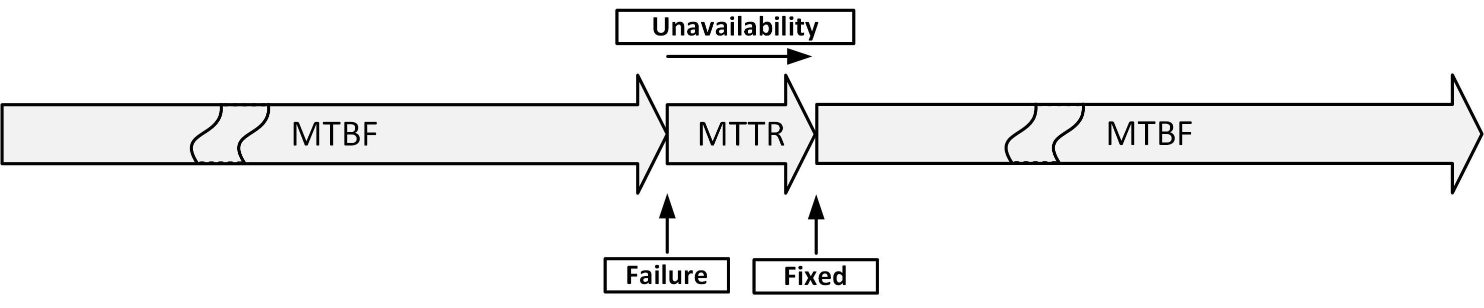
MTBF and MTTR
Mean Time Between Failures (MTBF)
The average time that passes between failures
Mean Time To Repair (MTTR)
The time it takes to recover from a failure

Slide 8
MTBF and MTTR
Some components have higher MTBF than others
Some typical MTB’s:

Slide 9
MTTR
MTTR can be kept low by:
Having a service contract with the supplier
Having spare parts on-site
Automated redundancy and failover

Slide 10
MTTR
Steps to complete repairs:
Notification of the fault (time before seeing an alarm message)
Processing the alarm
Finding the root cause of the error
Looking up repair information
Getting spare components from storage
Having technician come to the datacenter with the spare component
Physically repairing the fault
Restarting and testing the component

Slide 11

Calculation examples
$$Availability=\frac{MTBF}{\left(MTBF+MTTR\right)}×100\%$$

Slide 12
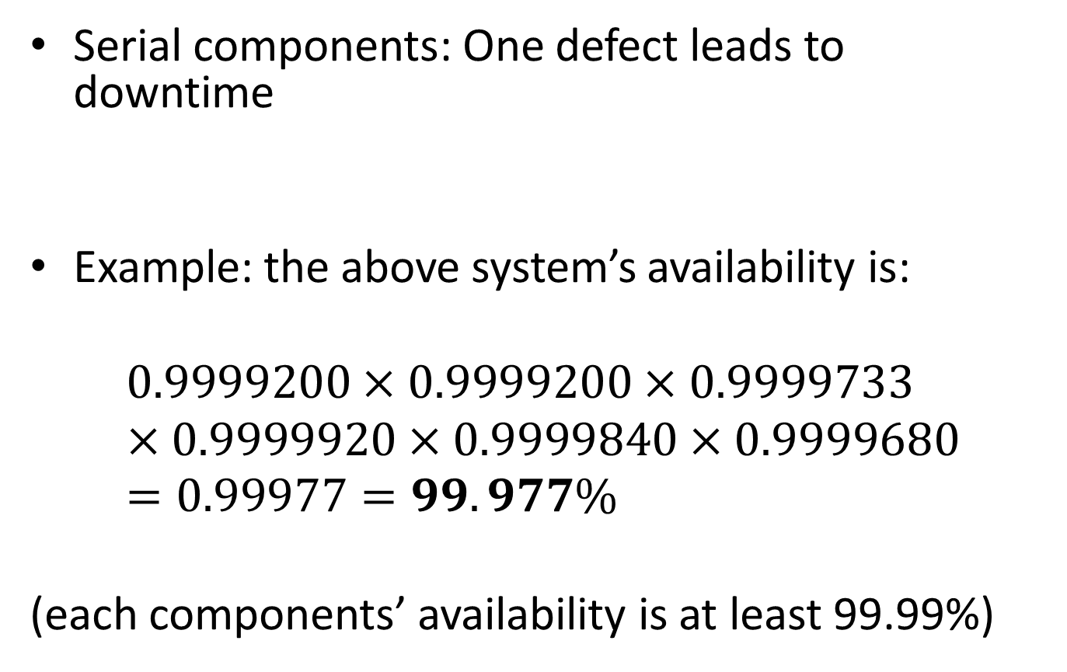
Calculation examples
Serial components: One defect leads to downtime
Example: the above system’s availability is:
$$0.9999200×0.9999200×0.9999733×0.9999920×0.9999840×0.9999680=0.99977=99.977\%$$
(each components’ availability is at least 99.99%)

Slide 13
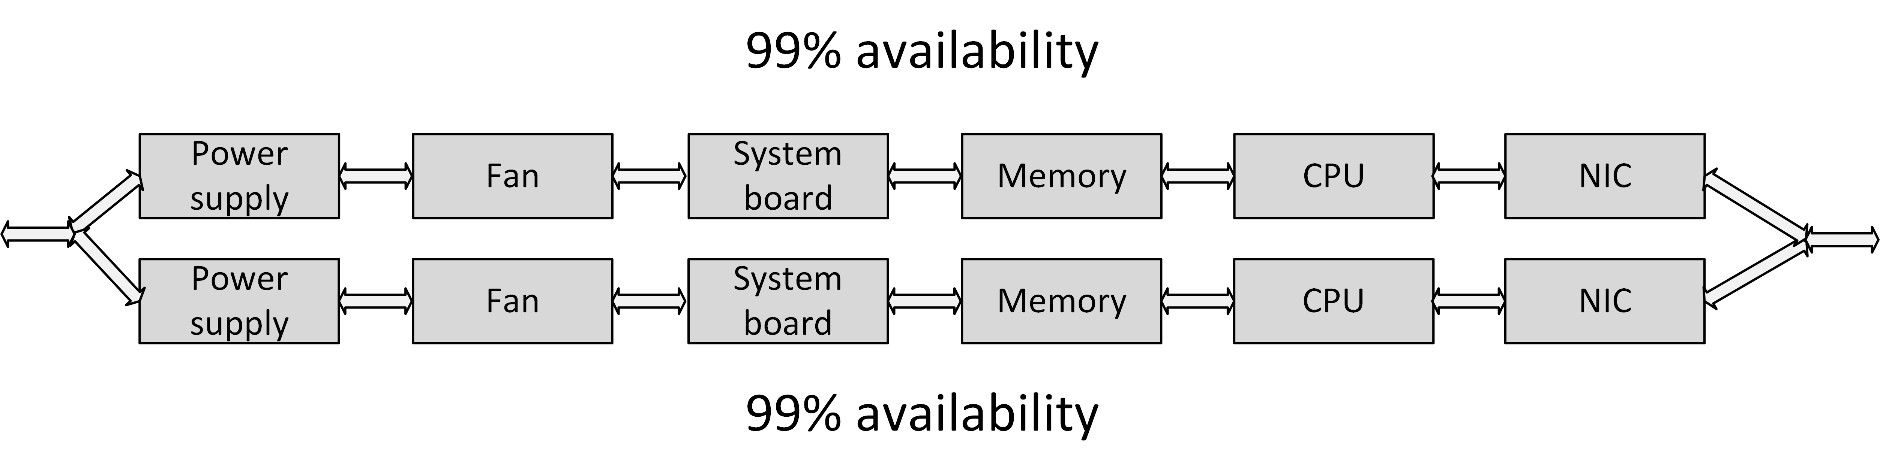
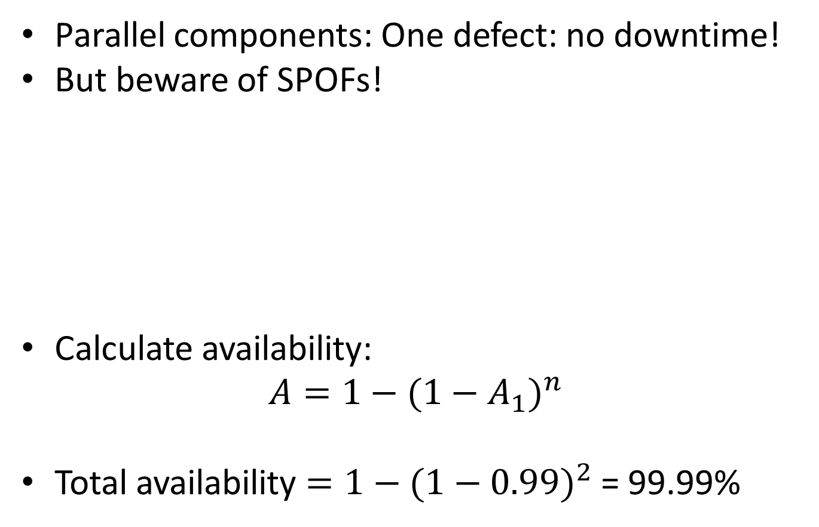
Calculation examples
Parallel components: One defect: no downtime!
But beware of SPOFs!
Calculate availability:
$$A=1−(1−A_{1})^{n}$$
Total availability $=1−(1−0.99)^{2}$ = 99.99%

Slide 14
Sources of unavailability - human errors
80% of outages impacting mission-critical services is caused by people and process issues
Examples:
Performing a test in the production environment
Switching off the wrong component for repair
Swapping a good working disk in a RAID set instead of the defective one
Restoring the wrong backup tape to production
Accidentally removing files
Mail folders, configuration files
Accidentally removing database entries
Drop table x instead of drop table y

Slide 15
Sources of unavailability - software bugs
Because of the complexity of most software it is nearly impossible (and very costly) to create bug-free software
Application software bugs can stop an entire system
Operating systems are software too
Operating systems containing bugs can lead to corrupted file systems, network failures, or other sources of unavailability

Slide 16
Sources of unavailability - planned maintenance
Sometimes needed to perform systems management tasks:
Upgrading hardware or software
Implementing software changes
Migrating data
Creation of backups
Should only be performed on parts of the infrastructure where other parts keep serving clients
During planned maintenance the system is more vulnerable to downtime than under normal circumstances
A temporary SPOF could be introduced
Systems managers could make mistakes

Slide 17
Sources of unavailability - physical defects
Everything breaks down eventually
Mechanical parts are most likely to break first
Examples:
Fans for cooling equipment usually break because of dust in the bearings
Disk drives contain moving parts
Tapes are very vulnerable to defects as the tape is spun on and off the reels all the time
Tape drives contain very sensitive pieces of mechanics that can break easily

Slide 18
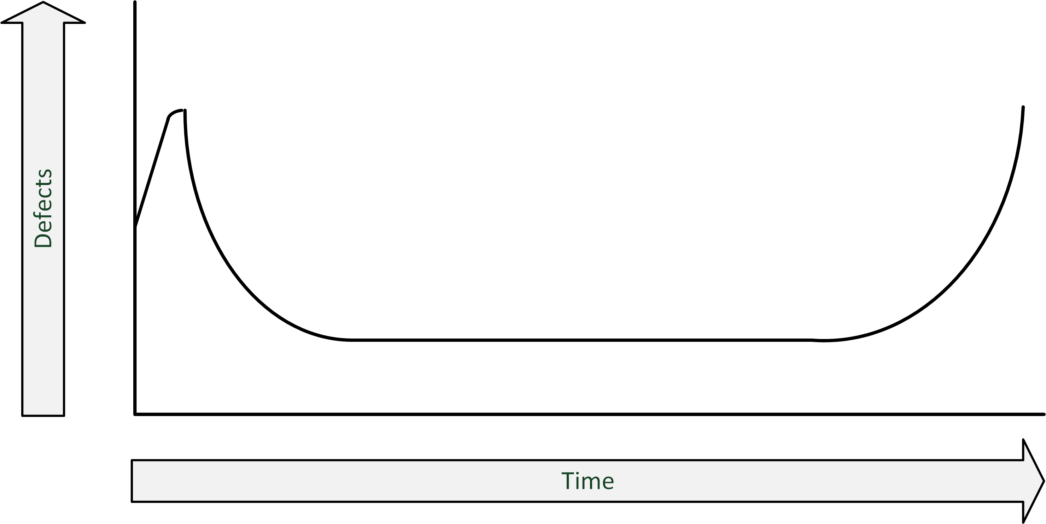
Sources of unavailability - bathtub curve
A component failure is most likely when the component is new
When a component still works after the first month, it is likely that it will continue working without failure until the end of its life

Slide 19
Sources of unavailability - environmental issues
Environmental issues can cause downtime:
Failing facilities
Power
Cooling
Disasters
Fire
Earthquakes
Flooding

Slide 20
Sources of unavailability - complexity of the infrastructure
Adding more components to an overall system design can undermine high availability
Even if the extra components are implemented to achieve high availability
Complex systems
Have more potential points of failure
Are more difficult to implement correctly
Are harder to manage
Sometimes it is better to just have an extra spare system in the closet than to use complex redundant systems

Slide 21
Redundancy
Redundancy is the duplication of critical components in a single system, to avoid a single point of failure (SPOF)
Examples:
A single component having two power supplies; if one fails, the other takes over
Dual networking interfaces
Redundant cabling

Slide 22
Failover
Failover is the (semi)automatic switch-over to a standby system or component
Examples:
Windows Server failover clustering
VMware High Availability
Oracle Real Application Cluster (RAC) database

Slide 23
Fallback
Fallback is the manual switchover to an identical standby computer system in a different location
Typically used for disaster recovery
Three basic forms of fallback solutions:
Hot site
Cold site
Warm site

Slide 24
Fallback – hot site
A hot site is
A fully configured fallback datacentre
Fully equipped with power and cooling
Applications are installed on the servers
Data is kept up-to-date to fully mirror the production system
Requires constant maintenance of the hardware, software, data, and applications to be sure the site accurately mirrors the state of the production site at all times

Slide 25
Fallback - cold site
Is ready for equipment to be brought in during an emergency, but no computer hardware is available at the site
Applications will need to be installed and current data fully restored from backups
If an organization has very little budget for a fallback site, a cold site may be better than nothing

Slide 26
Fallback - warm site
A computer facility readily available with power, cooling, and computers, but the applications may not be installed or configured
A mix between a hot site and cold site
Applications and data must be restored from backup media and tested
This typically takes a day

Slide 27
Business Continuity
An IT disaster is defined as an irreparable problem in a datacenter, making the datacenter unusable
Natural disasters:
Floods
Hurricanes
Tornadoes
Earthquakes
Manmade disasters:
Hazardous material spills
Infrastructure failure
Bio-terrorism

Slide 28
Business Continuity
In case of a disaster, the infrastructure could become unavailable, in some cases for a longer period of time
Business Continuity Management includes:
IT
Managing business processes
Availability of people and work places in disaster situations
Disaster recovery planning (DRP) contains a set of measures to take in case of a disaster, when (parts of) the IT infrastructure must be accommodated in an alternative location

Slide 29
RTO and RPO
RTO and RPO are objectives in case of a disaster
Recovery Time Objective (RTO)
The maximum duration of time within which a business process must be restored after a disaster, in order to avoid unacceptable consequences (like bankruptcy)

Slide 30
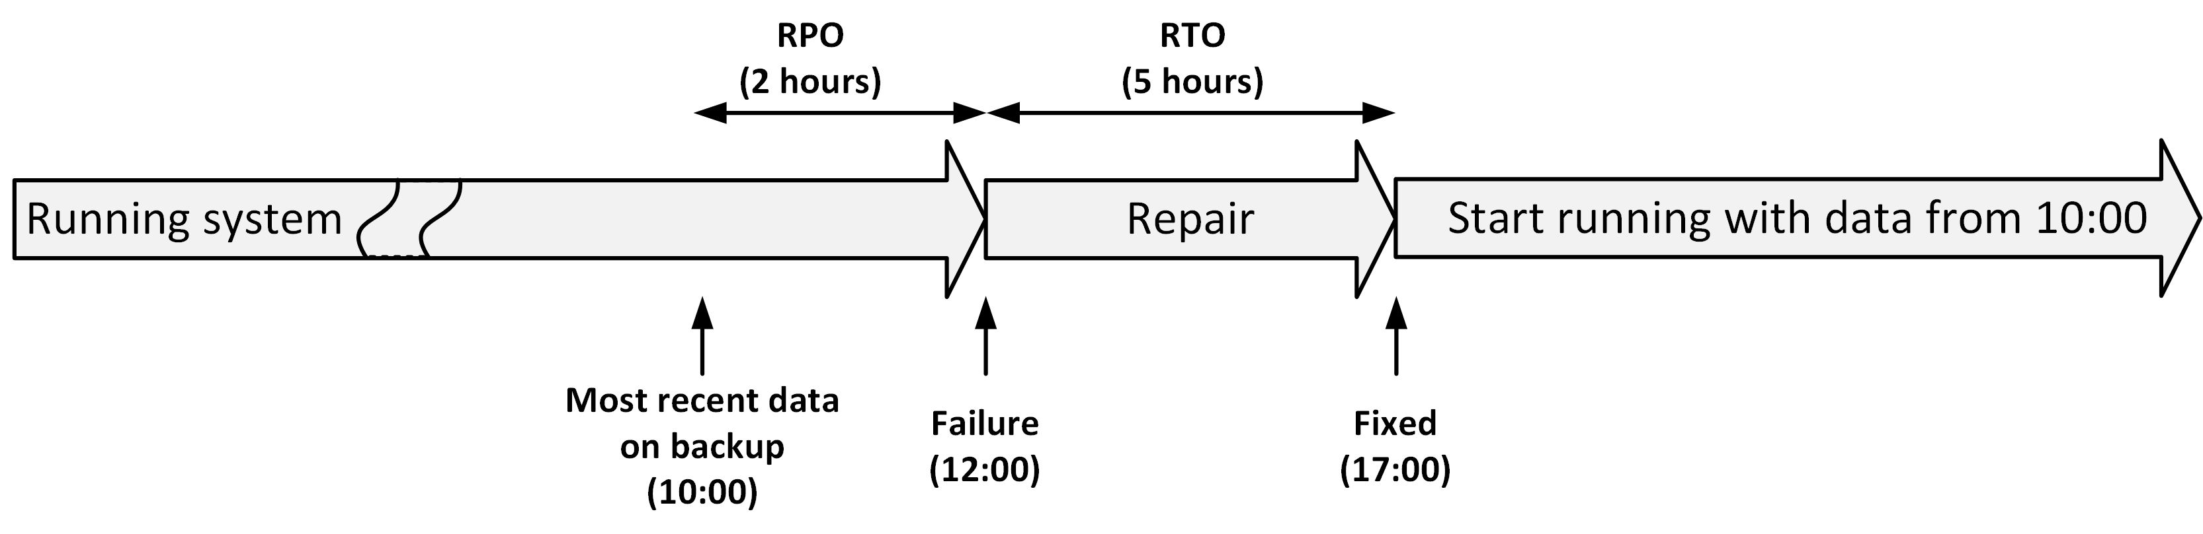
RTO and RPO
Recovery Point Objective (RPO)
The point in time to which data must be recovered considering some "acceptable loss" in a disaster situation
RTO and RPO are individual objectives
They are not related

